Slide 1
Currency converter using web application automation (RPa)
By: SAI SRIRAM KRISHNA PARIMI
(38119501)

Slide 2
INTRODUCTION
In this project , we will build an process to automate an currency converter web application using blue prism. The excepted outcome of this project are
Should launch the web application
Should able to take the values automatically from the Excel Sheet
Should be able to store the values back to the excel in the result column

Slide 3
oBJECTIVE
This project aims at developing a web based currency converter RPA application that serves the users to automate the process of converting currency. This application can automate the process of converting currencies in a given Excel file. Which results in less human effort and time consumption by improving efficiency.

Slide 4
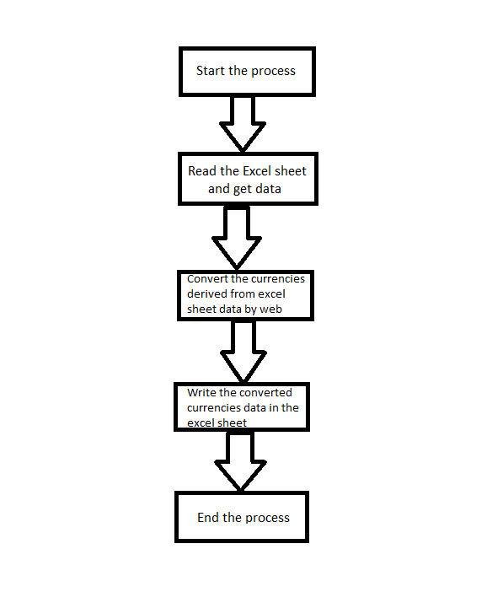
Ideation Map

Slide 5
Module implementation
Creating the Object from Object Studio
Spy the Elements.
Creating the Pages, Launch right-click.
Create A Page as “Input Value”.
Create Data Items
MS Excel VBO (Import VBO file)
Create Process Object as ”Web Automation T2 Process”.
Testing the Process Object from Object Studio
On Main Page, click on the Green play button to run the ‘Web Automation T2 Process’ Process object. It shows COMPLETED when there is no error or no failure in the object.

Slide 6
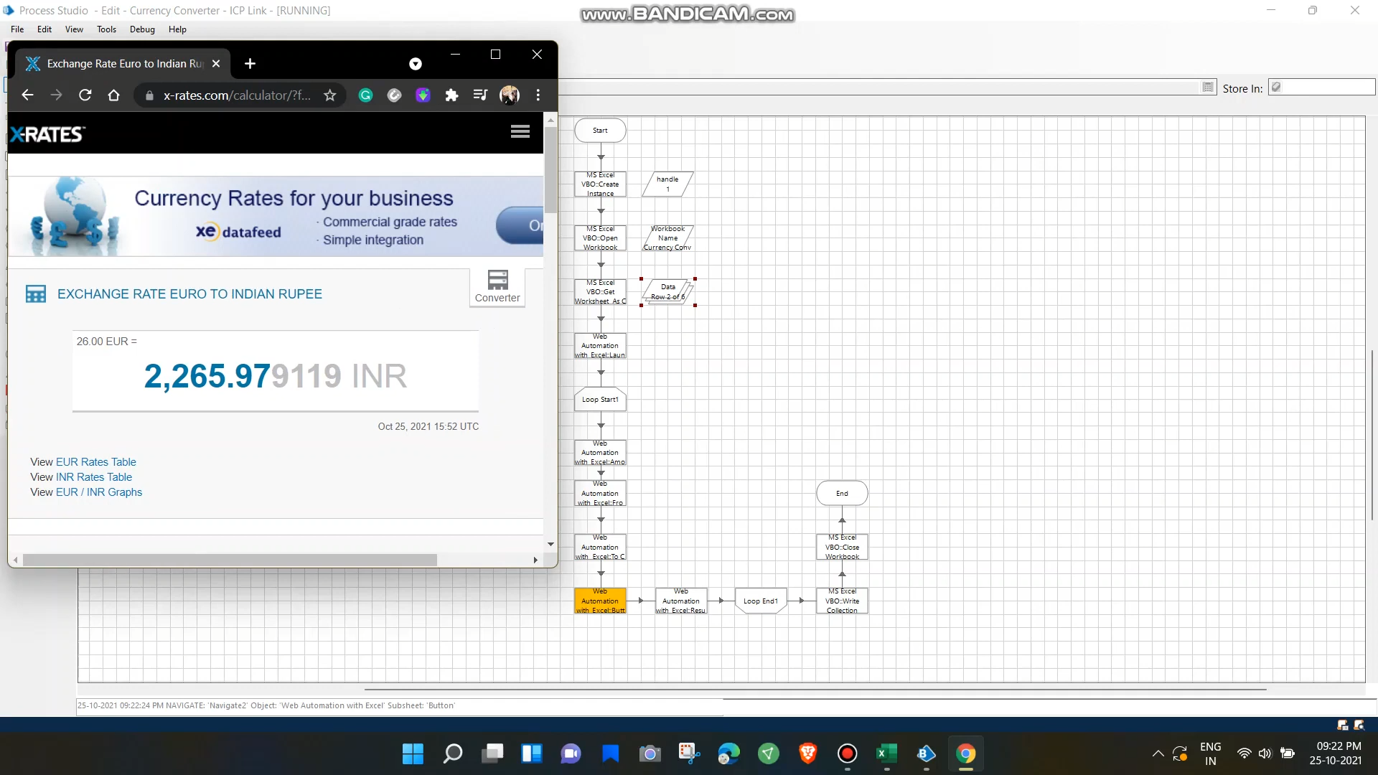
Application snapshots

Slide 7
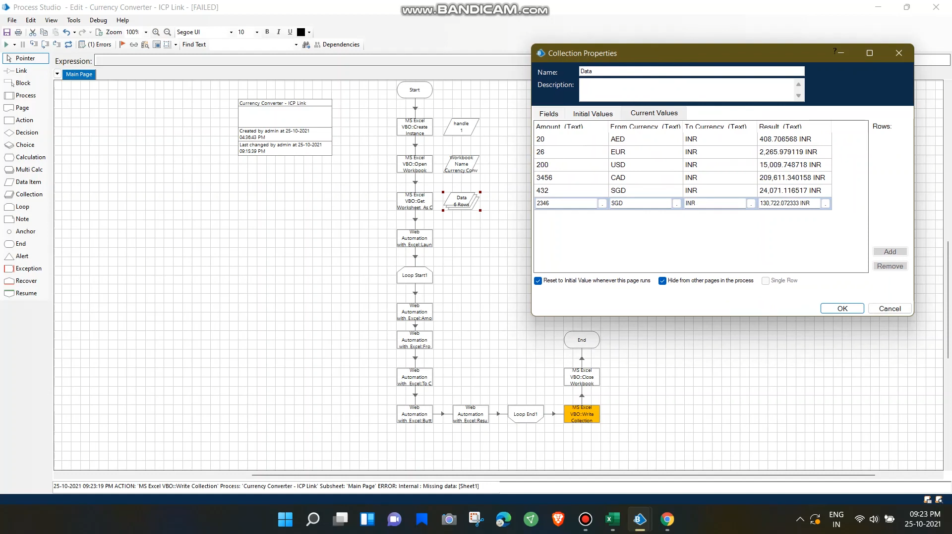
Results and discussions

Slide 8
Conclusion and future work
The objective of this project is to offer a Web based Robotic Process Automated application that can convert currency. Conclusion summarizing the entire work and findings. For the academic scope, this work has been carried out following widely accepted processes in the ﬁeld of research,thus granting high scientiﬁc rigor to the results obtained.
This can lead to the conclusion that the number of RPA researches will continue the growth in the future. Having in mind that RPA is a rather new and emerging field, the results identifying the appearance of 17 conference papers against 10 journal articles imply that the full research potential on RPA topic hasn’t been achieved yet. Hence, it can be concluded that the studies on RPA have only begun to emerge and it is expected they will achieve its proliferation in the next few years.The way forward for RPA will be by integrating with AI and ML.

Slide 9
references
https://www.researchgate.net/publication/339341848_Robotic_Process_Automation_A_Scientific_and_Industrial_Systematic_Mapping_Study
https://www.ops.gov.ie/app/uploads/2021/01/RPA-SystematicLiteratureSurvey.pdf
https://www.researchgate.net/publication/335400552_Robotic_Process_Automation_Systematic_Literature_Review

